Slide 1
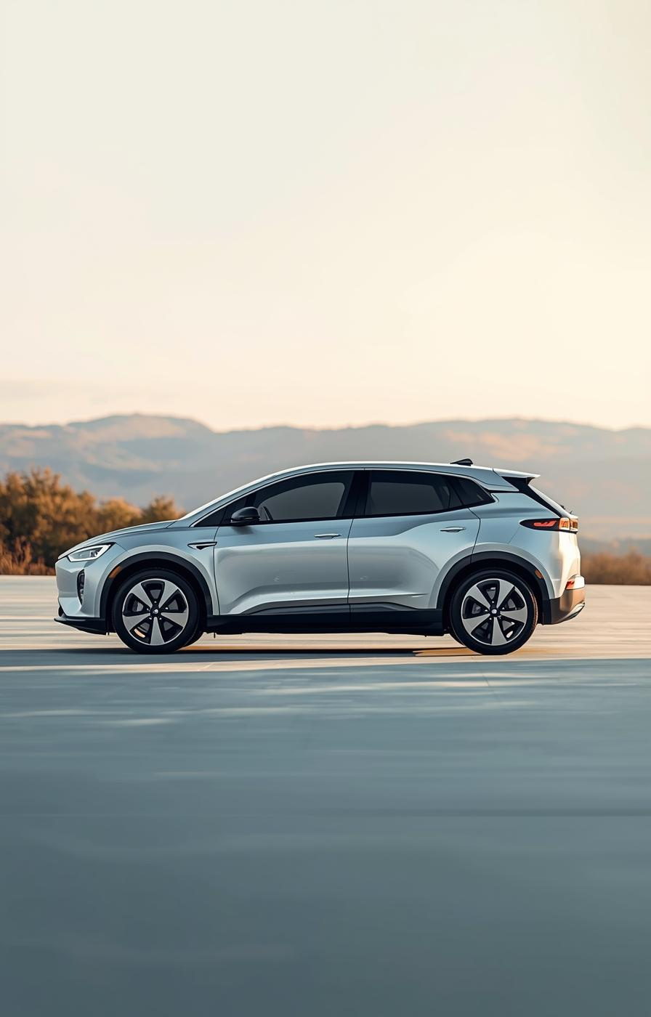

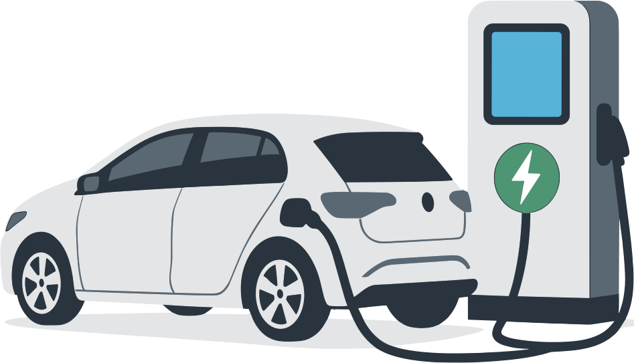
India EV Market Analysis
Subhojeet Sarkar

Slide 2
Overview & Objective
Insights into the EV Market
This presentation aims to analyze India's rapidly evolving EV market, highlighting consumer behavior, identifying growth opportunities, and providing strategic recommendations for successful market entry and expansion.
2

Slide 3
Agenda
About Company
Competitive Landscape
Market Overview
Govt. Schemes
Consumer Insights
SWOT Analysis
Purchase Decision Factors
Primary & Secondary Question
3

Slide 4
About Company & Background
Our Company :
AtliQ Motors is a leading automotive company from the USA, specializing in electric vehicles (EV) with a 25% market share in North America's EV and hybrid segment.
Background :
AtliQ Motors aims to expand its presence in India, where its current market share in EVs and hybrids is less than 2%.
Context :
Bruce Haryali, Chief of AtliQ Motors India, is conducting a detailed market study of the existing EV/Hybrid vehicle market in India to guide the company's expansion plans
4

Slide 5
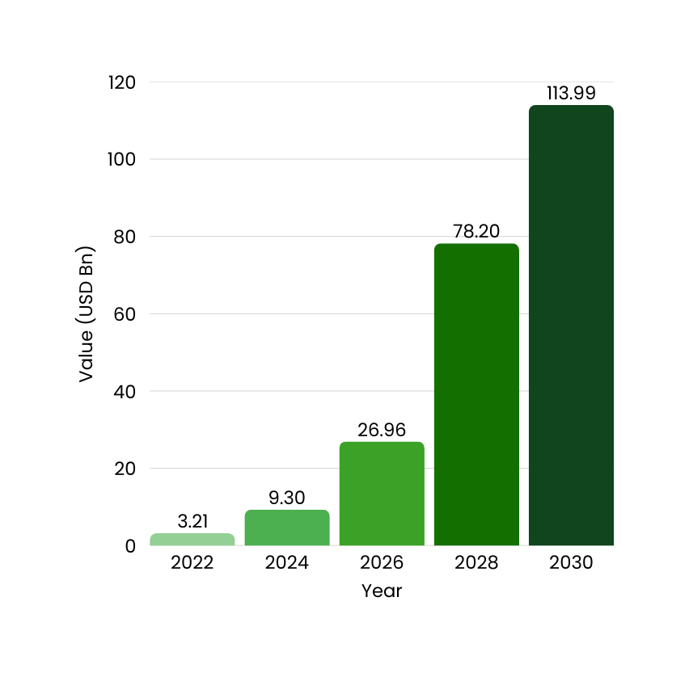
Market Overview
In 2022, the Indian EV industry was estimated to be worth $3.21 billion in its early stages of adoption.
With a CAGR of 34.02% and substantial growth potential, it is anticipated to reach $113.99 billion by 2030.
Growth is fueled by advances in technology, growing demand, and government backing.
5

Slide 6
EV Sales Milestones
FAME II Launch
COVID-19 Dip
UP Leads 3W Sales
Ola Electric Entry
YoY Growth Surge
The launch of the FAME II scheme in 2019 significantly boosted electric vehicle sales by providing subsidies and incentives to consumers and manufacturers, stimulating market interest.
In 2020, the COVID-19 pandemic caused a temporary dip in electric vehicle sales due to lockdowns and supply chain disruptions, affecting the momentum of the growing market.
By 2021, Uttar Pradesh emerged as a leader in three-wheeler electric vehicle sales, driven by increased adoption and supportive local government initiatives to promote EV usage.
Ola Electric made a strong market entry in 2022, capturing consumer attention with its innovative electric scooter and strategic marketing, making significant inroads into the competitive landscape.
In 2024, the electric vehicle market experienced a remarkable 68.81% year-on-year growth, underscoring the accelerating demand and expanding infrastructure supporting electric mobility across India.

Slide 7

Key States in EV Market
State | Total EV Sales (2023) | EVPR%
Maharastra | 1,94,343 | 6.49
Karnataka | 1,52,680 | 7.84
Rajasthan | 93,767 | 4.55
Tamil Nadu | 90,288 | 4.30
Gujarat | 88,615 | 4.40
The Indian EV market is strongly driven by key states like Maharashtra and Karnataka, which showcase significant sales volumes, reinforcing the country's potential for growth and consumer adoption of electric vehicles.

Slide 8
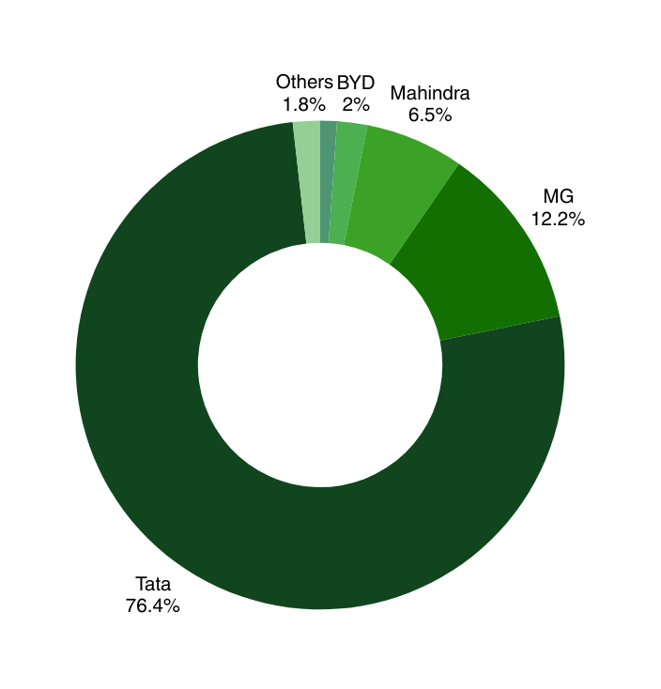
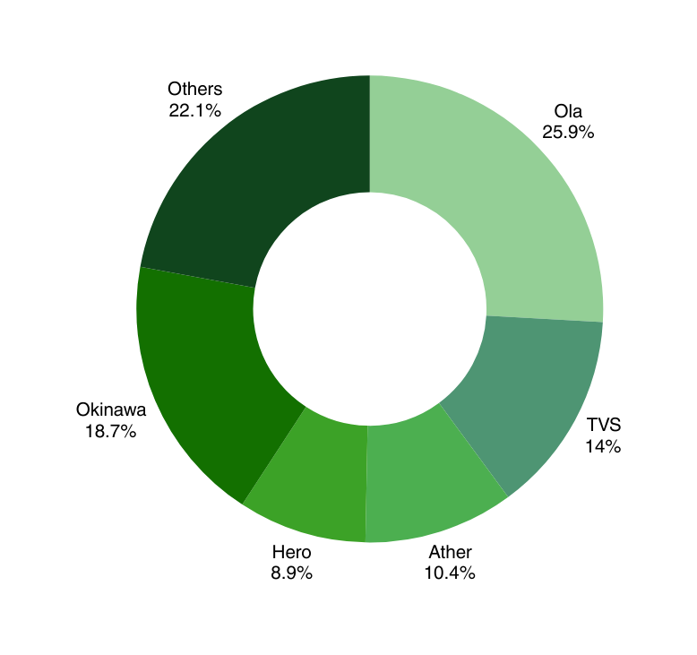
Key Players in EV Market
2-Wheeler Segment
4-Wheeler Segment

Slide 9
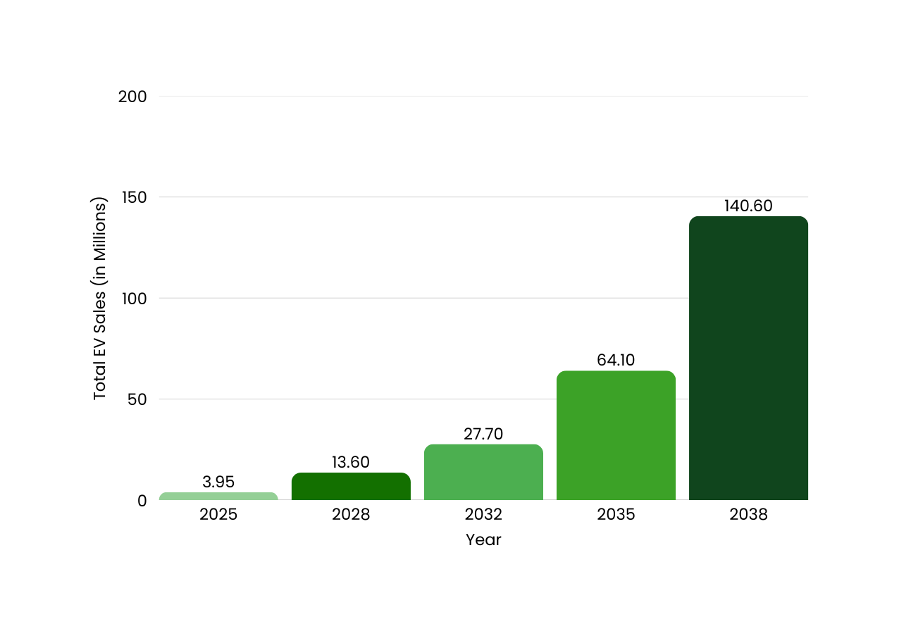
EV Sales Forecast
9

Slide 10
Consumer Insights
Understanding EV Buyers and Their Profiles
10

Slide 11
Demographic Insights
Understanding India's EV Buyer Profiles
Urban Consumers
Age Focus
Buyer Segments
The urban demographic, primarily high-income individuals, showcases a strong affinity for technology, making them ideal candidates for electric vehicle adoption.
Focusing on the 18-32 age group, which includes Millennials and Gen Z, reveals a youthful enthusiasm for sustainable transport and innovative technologies, driving market growth.
The three key segments—Conservatives, Indifferents, and Enthusiasts—demonstrate varied motivations and concerns, shaping their purchasing decisions and attitudes toward electric vehicles.
11

Slide 12
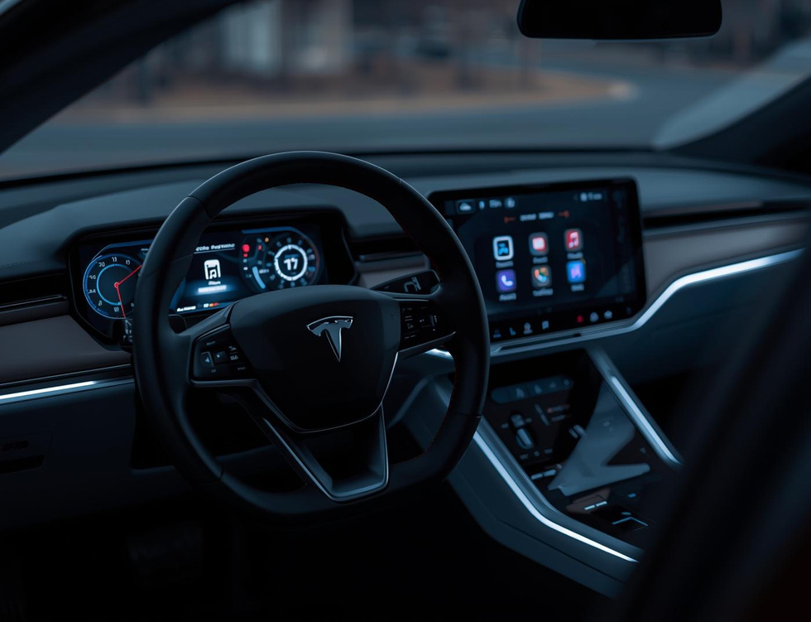


Consumer Segments
Tech Enthusiasts
Eco-Conscious
Budget-Conscious
Tech enthusiasts prefer innovative features and cutting-edge technology in their electric vehicles.
Eco-conscious buyers prioritize sustainability and environmental impact when choosing electric vehicles.
Budget-conscious consumers seek value and long-term savings when investing in electric vehicles.

Slide 13
Behavioral Insights
Understanding consumer motivations in depth
Long-Term Savers
Informed Buyers
Key Motivators
Long-term savers prioritize cost benefits, focusing on overall savings from reduced fuel expenses and lower maintenance costs, making EVs appealing for their economic viability.
Informed buyers seek comprehensive knowledge about EV technology, reliability, and total cost of ownership, ensuring they make educated decisions based on thorough research and comparison.
Key motivators for both segments include government incentives, environmental benefits, and advancements in charging infrastructure, which significantly influence their purchasing decisions and brand loyalty.
13

Slide 14
Purchase Decision Factors
Positives and negatives influencing choices
14

Slide 15
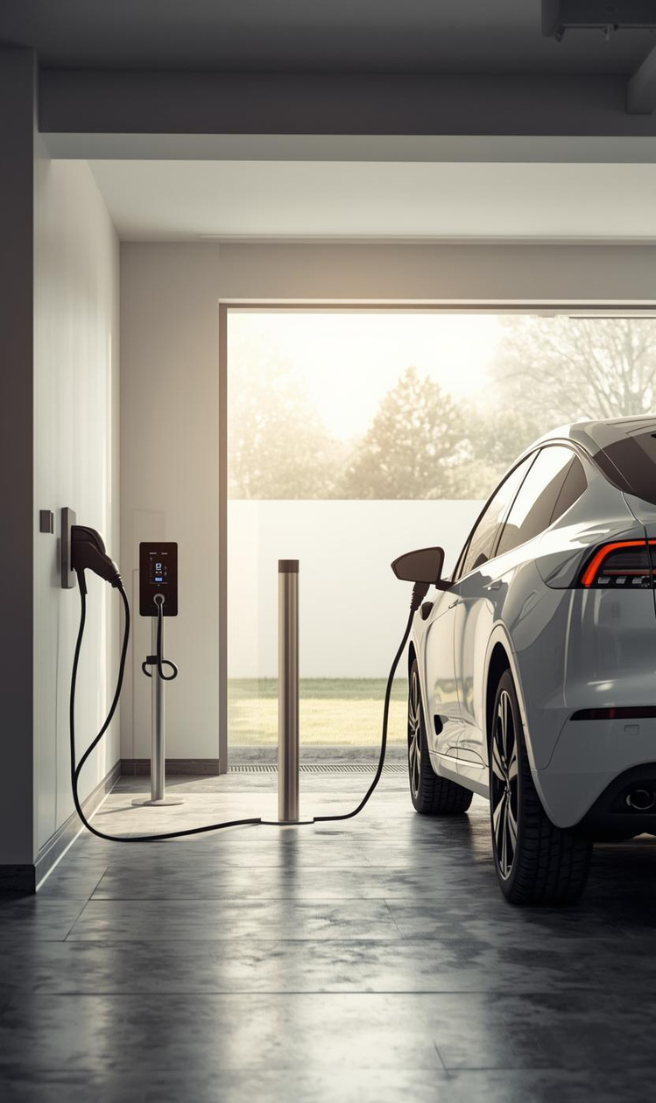

Positive Influences on EV Purchases
Upfront Cost
Long-Term Savings
Initial price ranges from ₹10–15 lakhs.
Significant savings on fuel and maintenance costs.

Slide 16
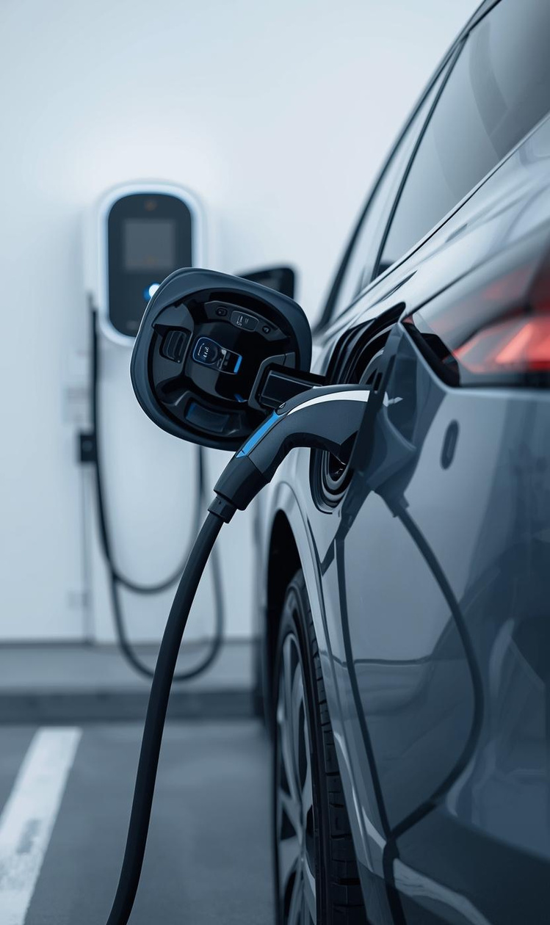
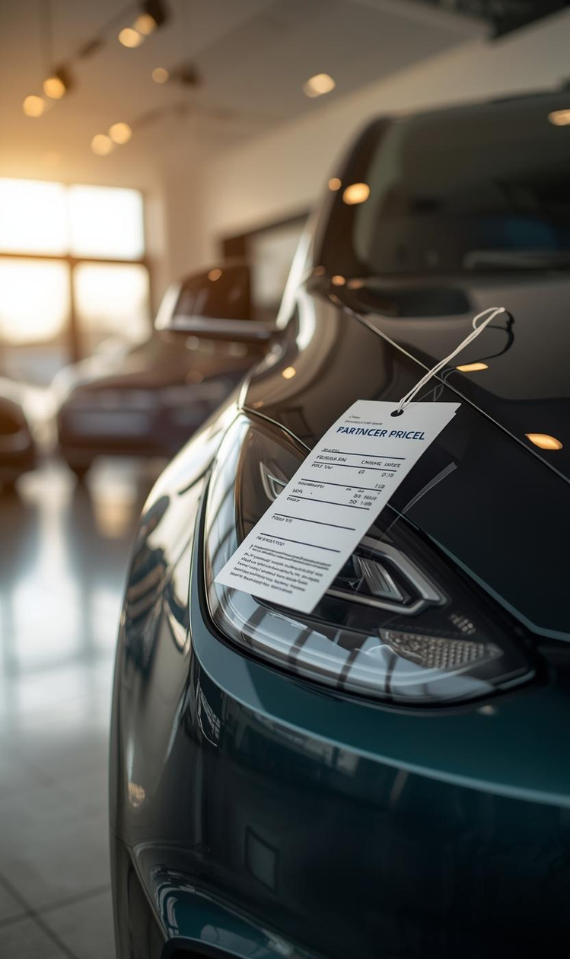
Challenges in the EV Market
Range Anxiety
Charging Infrastructure
Concerns over limited driving range persist.
Limited stations restrict consumer confidence and access.

Slide 17
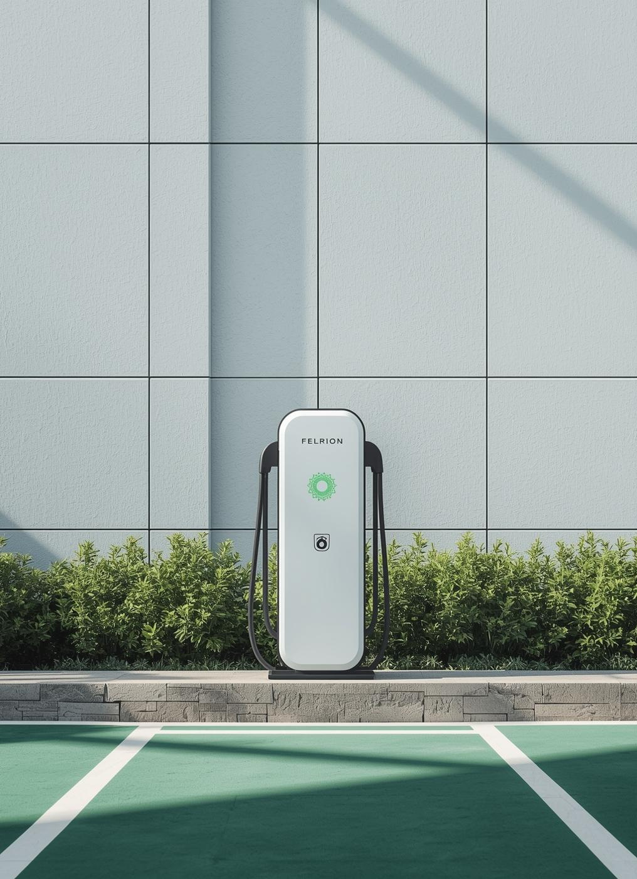
Charging Infrastructure Overview
As of August 2024, India boasts over 1,500 public charging stations, primarily located in urban areas. This growing infrastructure is vital for ensuring convenient access and encouraging the adoption of electric vehicles.

Slide 18

Charging Infrastructure
State | Operational PCs
Maharastra | 3079
Delhi | 1886
Karnataka | 1051
Kerala | 852
Tamil Nadu | 643
Uttar Pradesh | 582
Rajasthan | 500
Telangana | 481
Gujarat | 476

Slide 19
Competitive Landscape
Key players in India's EV market
Established Players
2W Segment - Ola Electric, TVS, Ather, Okinawa
4W Segment - Tata Motors, MG Motors, Mahindra, BMW
New Entrants
2W Segment - Simple Energy, Ultraviolet Automotive
4W Segment - BYD, Pravig Dynamics
Upcoming Entrants
2W Segment - Boom Motors
4W Segment - Fisker Inc
19

Slide 20
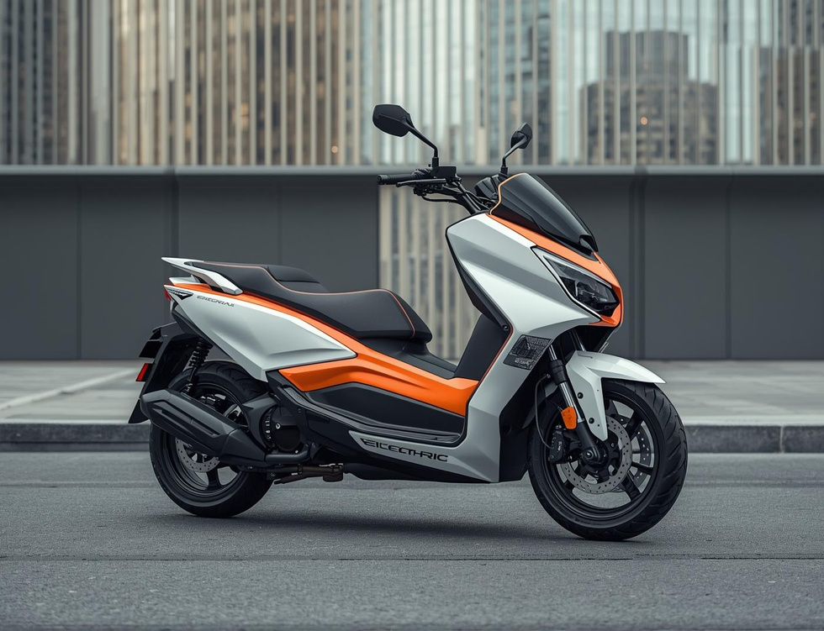
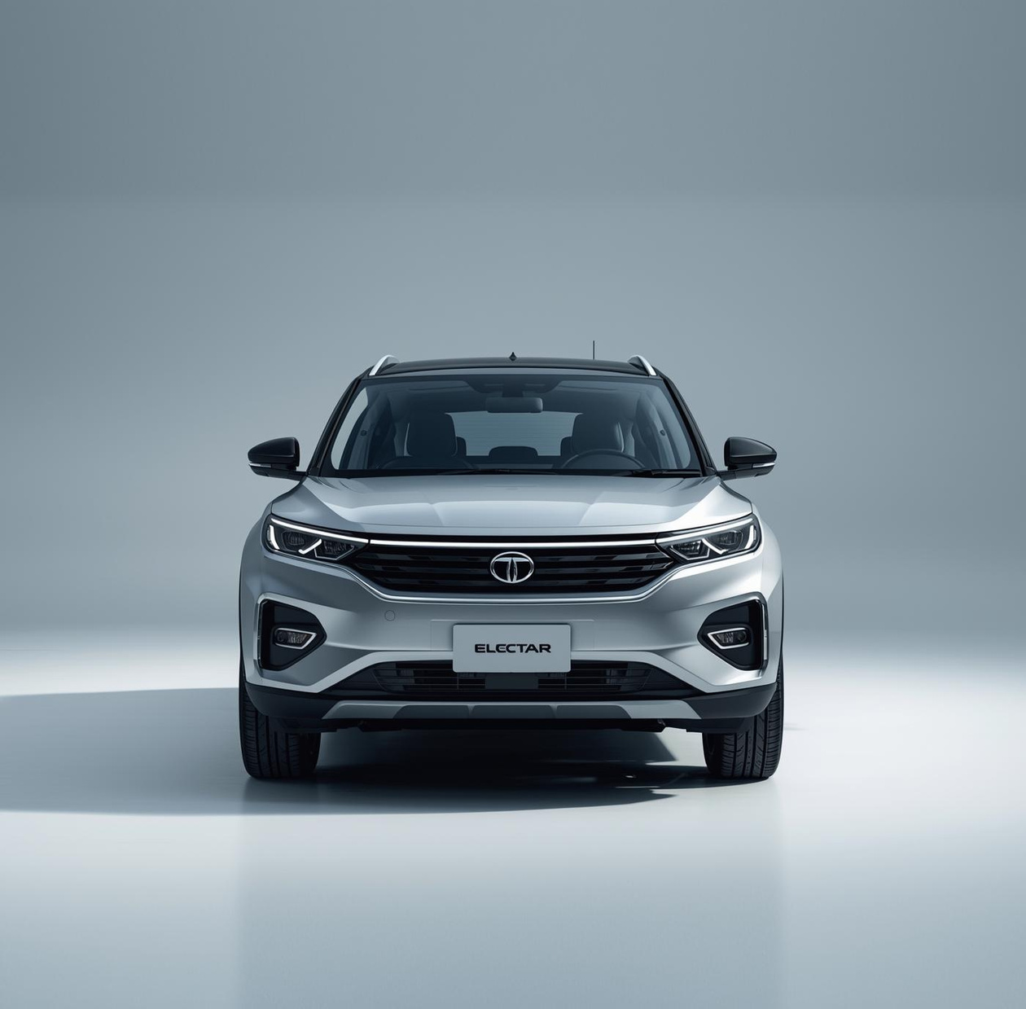
Key Players
Two-Wheelers
Four-Wheelers
Ola, TVS, and Ather lead India’s two-wheeler EV segment with innovative offerings and technology.
Tata, MG, and Mahindra are key players in the four-wheeler market, showcasing robust growth and innovation.

Slide 21
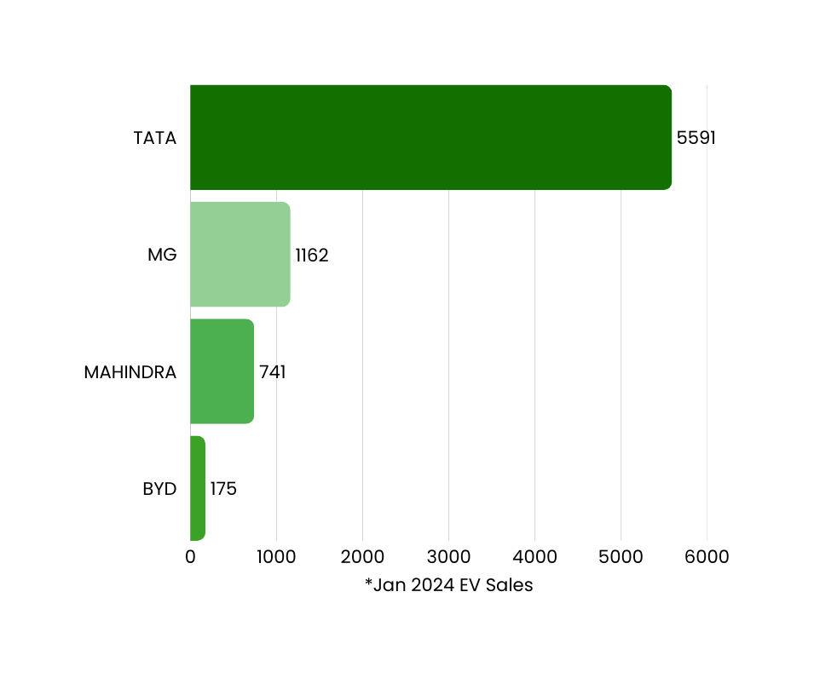
Sales Figures
A comparison of top-selling 4W brands in the Indian EV market.

Slide 22
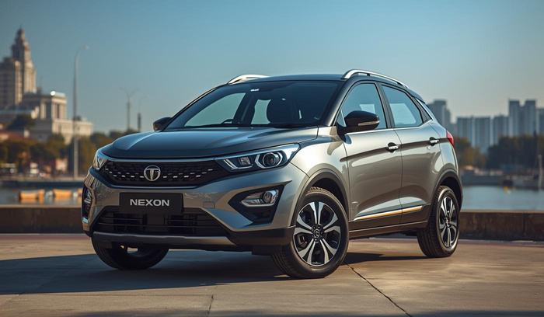
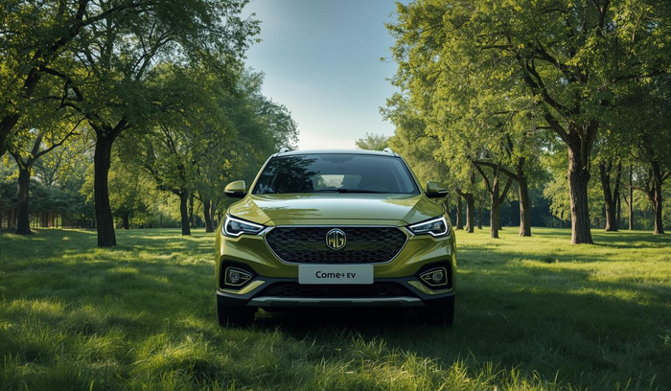
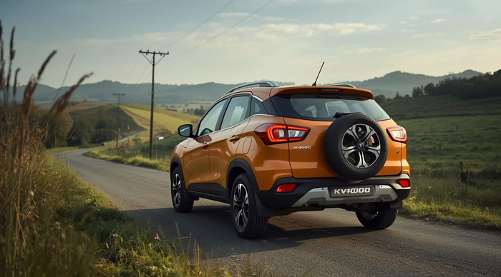
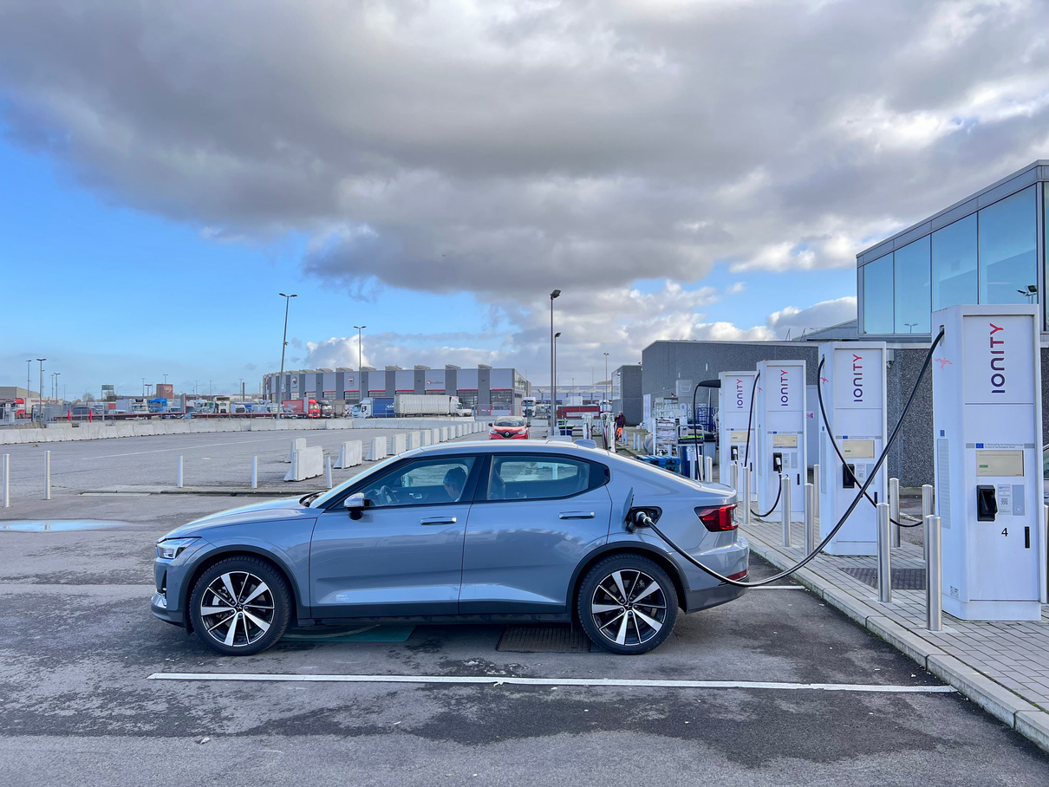

Unique Selling Propositions of Top EV Models
Tata Nexon EV
MG Comet EV
Offers strong brand strength and extensive service network.
Known for its affordability and city-friendly design.
Mahindra KUV400
BYD Atto 3
Features a spacious design for comfort and functionality.
Features an advanced battery tech and a premium feel.

Slide 23
Brand Comparison Overview
Brand | EV Model | NCAP Result | Battery | Displacement | Price | ARAI Range
Tata | Nexon EV | 5 Star | 30 kWh, 40.5 kWh | 129-149 hp | Rs. 14.74 - Rs. 19.94 Lakhs | 395 KM
MG | ZS EV | 5 Star | 50.3 kWh | 174 hp | Rs. 23.08 - Rs. 28.00 Lakhs | 461 KM
Mahindra | KUV 400 | --- | 34.5 kWh, 39.4 kWh | 150 hp | Rs. 15.99 - Rs. 18.99 Lakhs | 456 KM
BYD | Atto 3 | 5 Star | 60.48 kWh | 201 hp | Rs. 33.94 - Rs. 34.99 Lakhs | 521 KM
ARAI Range - Claimed range under lab circumstances

Slide 24
Competitive Positioning
TATA's Market Dominance in EVs
TATA commands a significant share of the EV market, showcasing strong brand strength and extensive network, leading to substantial consumer trust and sales figures across various vehicle segments.
24

Slide 25
Government Policies
Regulatory environment and incentives overview
25

Slide 26


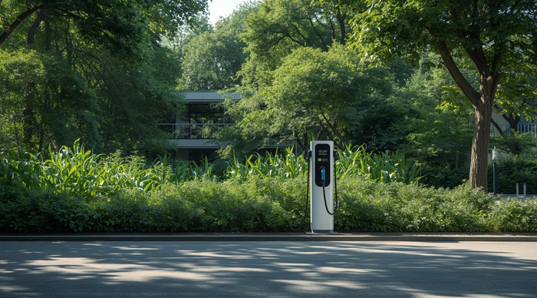
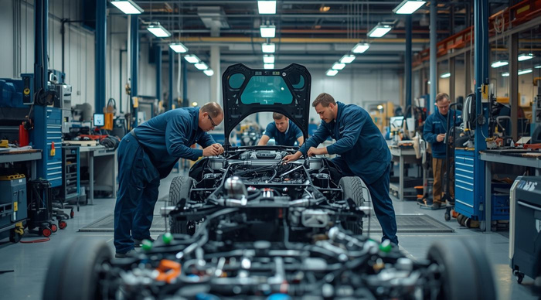
Overview of Key Government Schemes
FAME II
PLI
Focuses on incentives for electric vehicle adoption
Aims to boost local manufacturing of EVs
BS Policy
E-Mobility
Stricter emissions norms to enhance environmental goals
Promotes electric vehicle use in urban areas

Slide 27
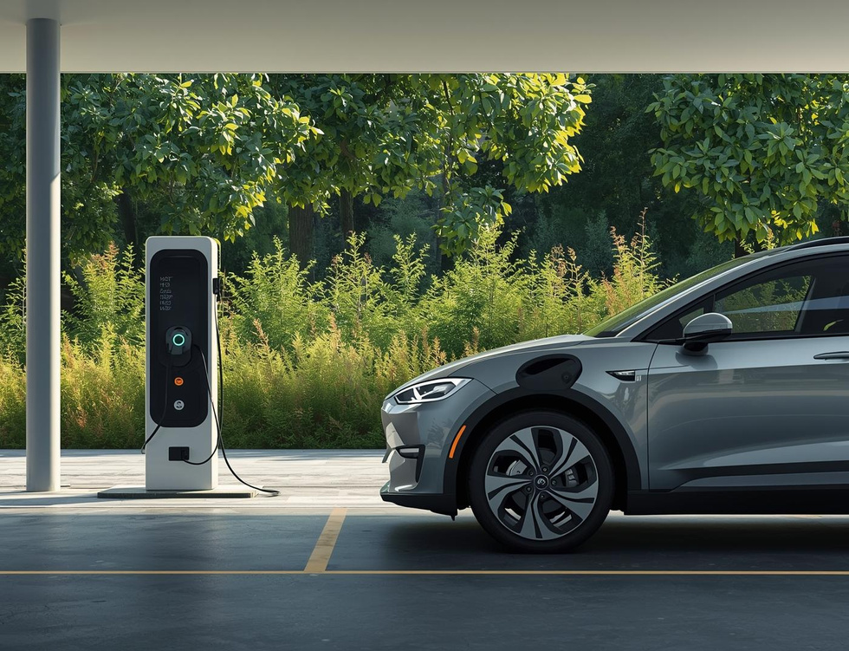
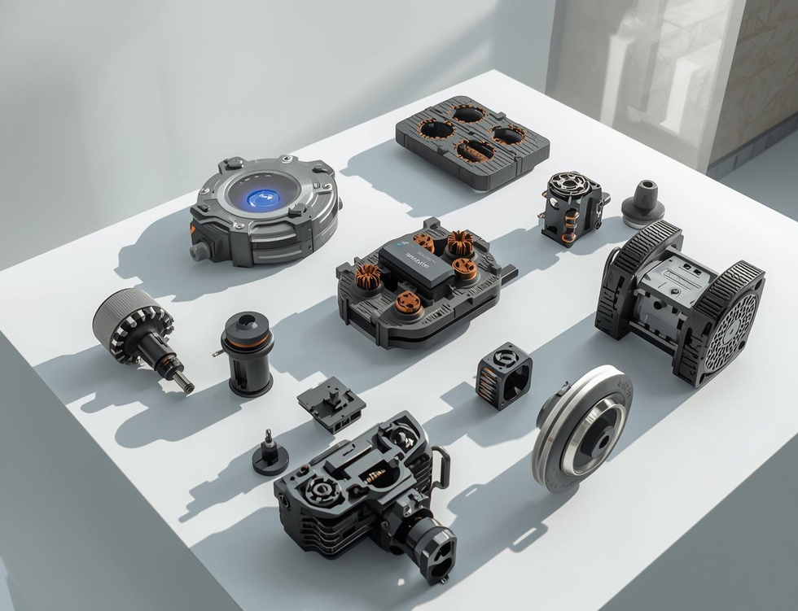
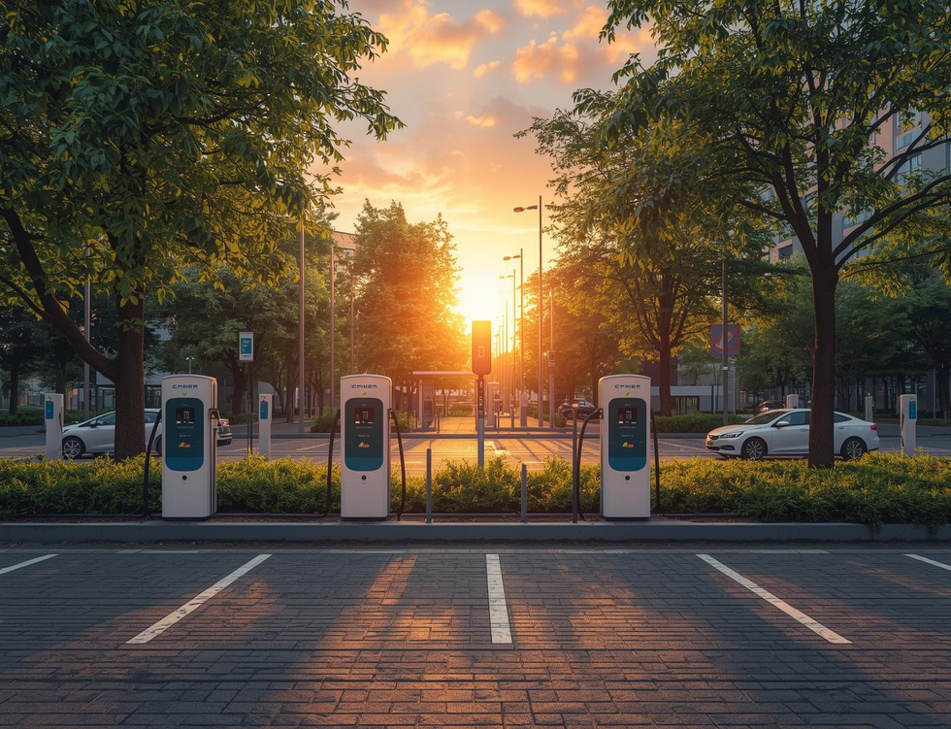
Key Beneficiary Schemes
PLI Scheme
Duty Reduction
NEMMP
The PLI scheme supports local manufacturing of EV components to boost economic growth.
Duty reductions on crucial materials encourage cost-effective production of electric vehicles.
The NEMMP aims for 6-7 million EVs by 2030 to enhance eco-friendly transportation.

Slide 28
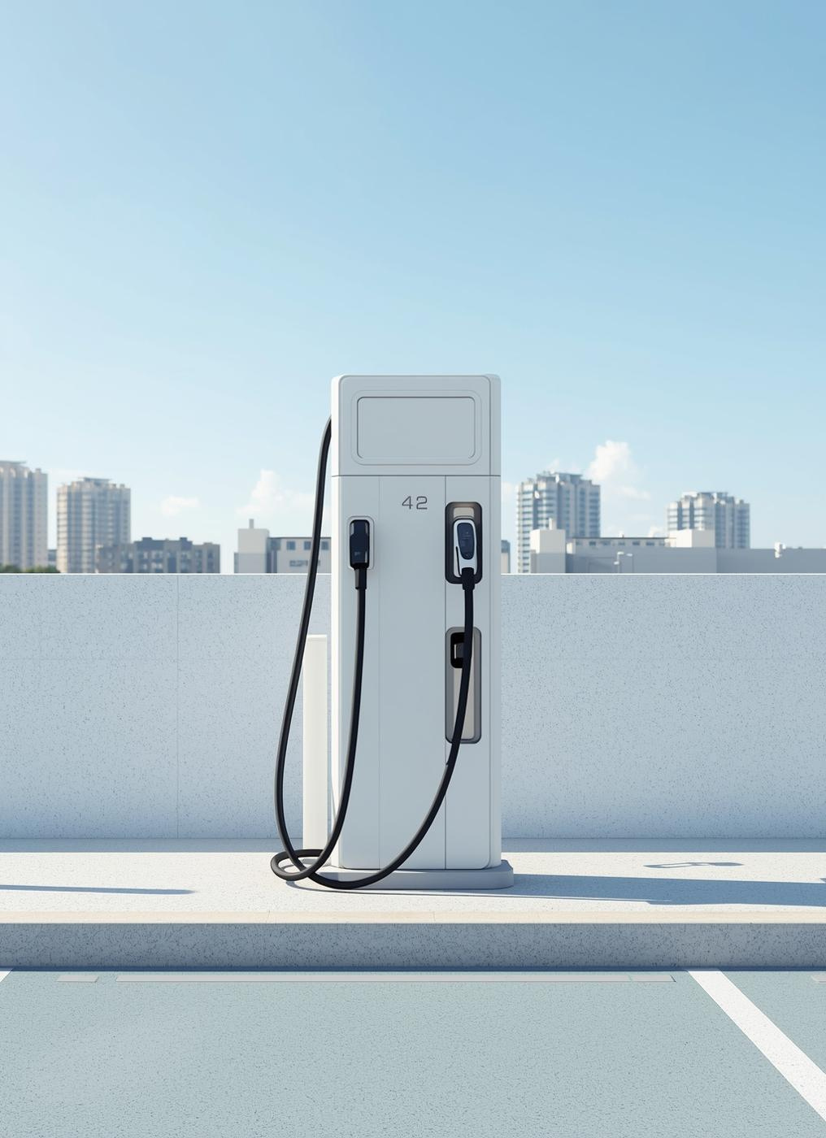
Regulatory Insights
Recent policy changes have significantly impacted the EV landscape in India, including a reduction of GST to 5%, implementation of stricter emission norms, and a commitment to expanding charging infrastructure nationwide.

Slide 29
SWOT Analysis
Internal and external market factors
29

Slide 30

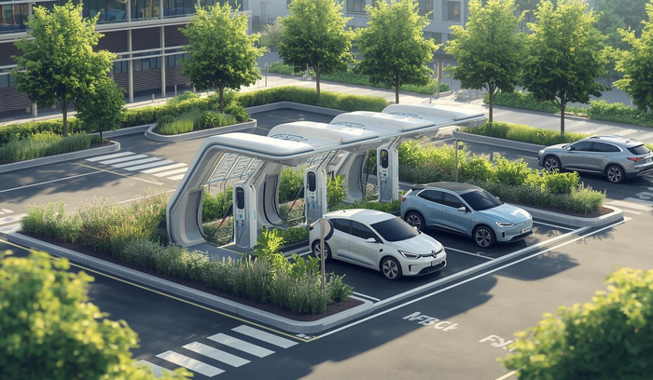
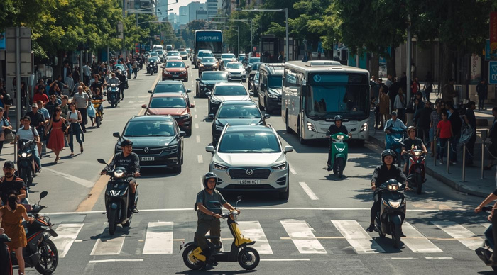
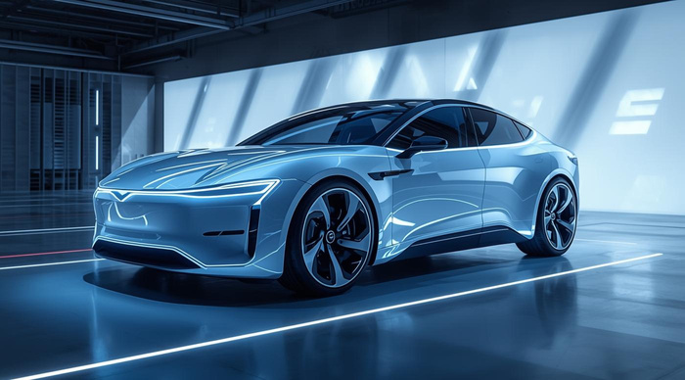
Strengths of the Indian EV Market
Government Support
Growing Demand
Strong policies promote EV adoption and growth.
Increasing interest from consumers drives market expansion.
Technological Advancements
Infrastructure Development
Innovations enhance the efficiency of electric vehicles.
Expanding networks facilitate EV accessibility.

Slide 31

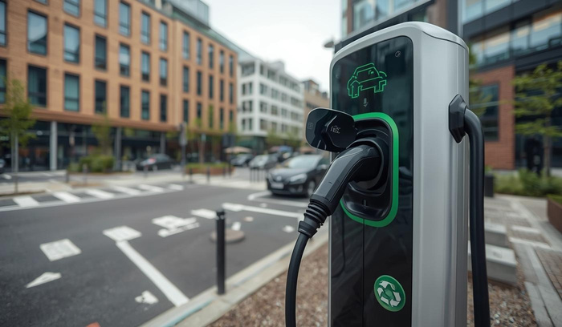
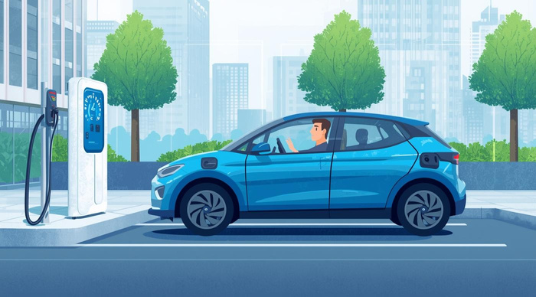
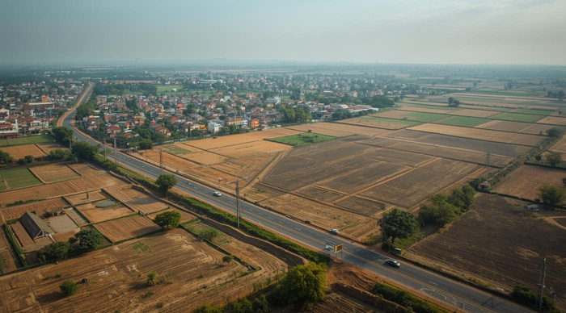
Weaknesses in the Indian EV Market
High Cost
Limited Range
The initial investment for EVs remains significant.
Many consumers fear the inconvenience of charging.
Low Rural Penetration
Infrastructure Gaps
EV adoption in rural areas is extremely limited.
Insufficient charging stations in non-urban regions.

Slide 32




Unlocking Potential in the EV Market
Market Growth
Innovative Solutions
Expanding EV adoption across diverse demographics.
New technologies driving efficiency and performance.
Strategic Alliances
Sustainable Partnerships
Collaborations enhancing market reach and impact.
Long-term relationships fostering eco-friendly initiatives.

Slide 33

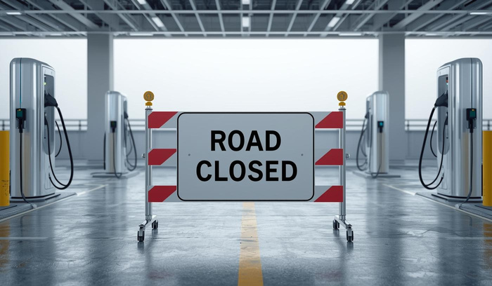
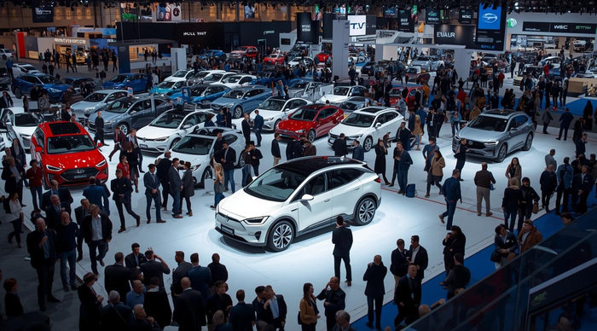

Key Threats to the EV Market
Competition
Regulatory Changes
Increased number of entrants in the market
Frequent policy updates affecting industry stability
Consumer Skepticism
Market Volatility
Concerns regarding EV performance and reliability
Fluctuating demand impacting investment decisions

Slide 34
Market Trends & Forecasts
Sales trends and growth projections analysis
34

Slide 35
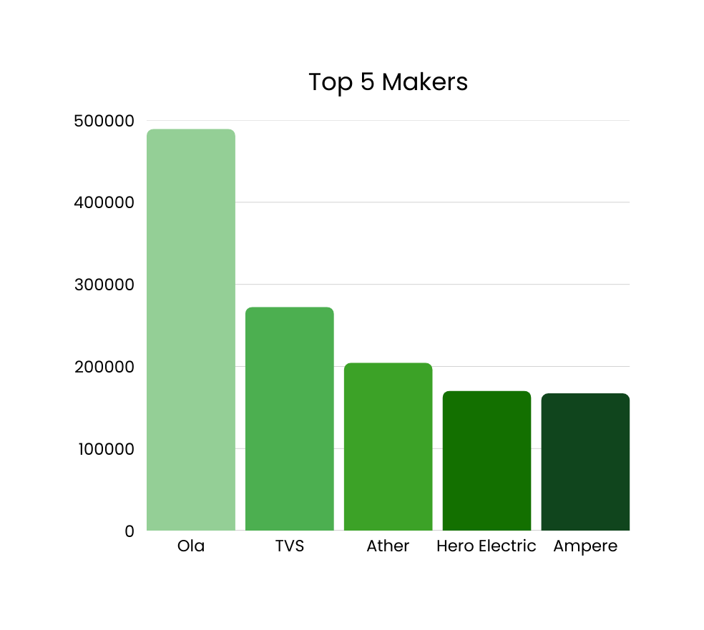
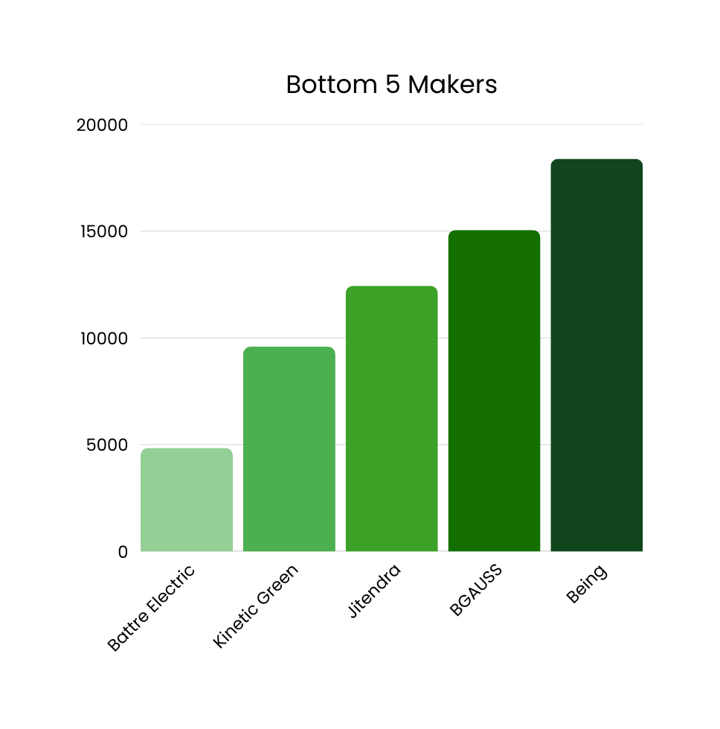
Top & Bottom 5 Makers by 2W Sales

Slide 36
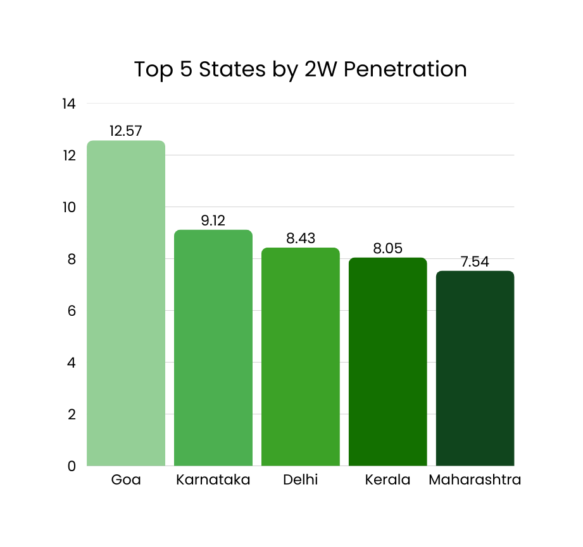
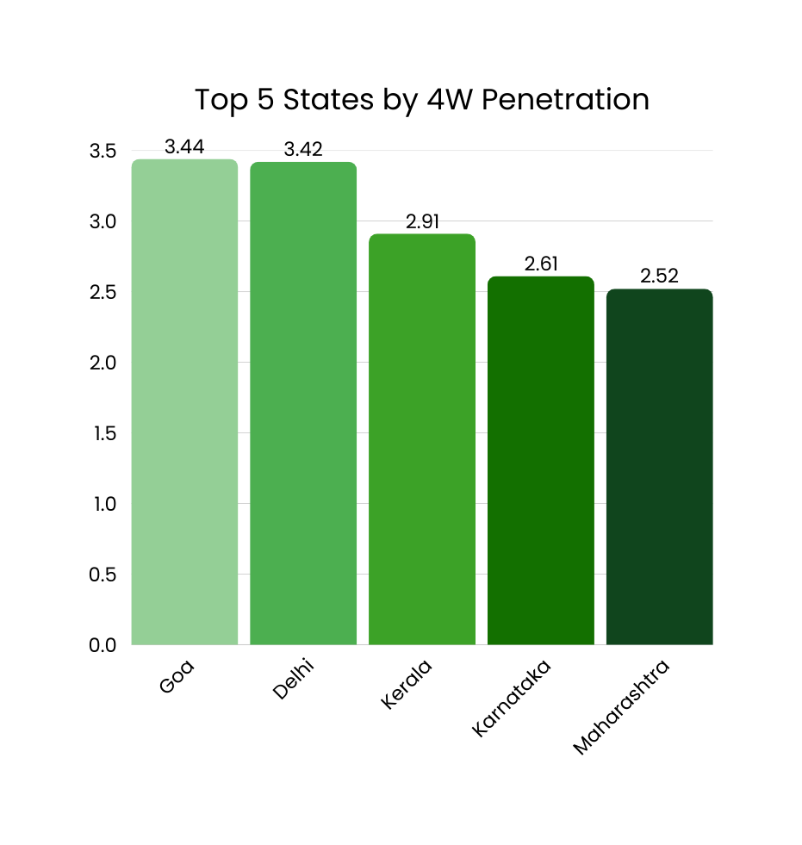
Top 5 States by 2W & 4W EV Penetration

Slide 37
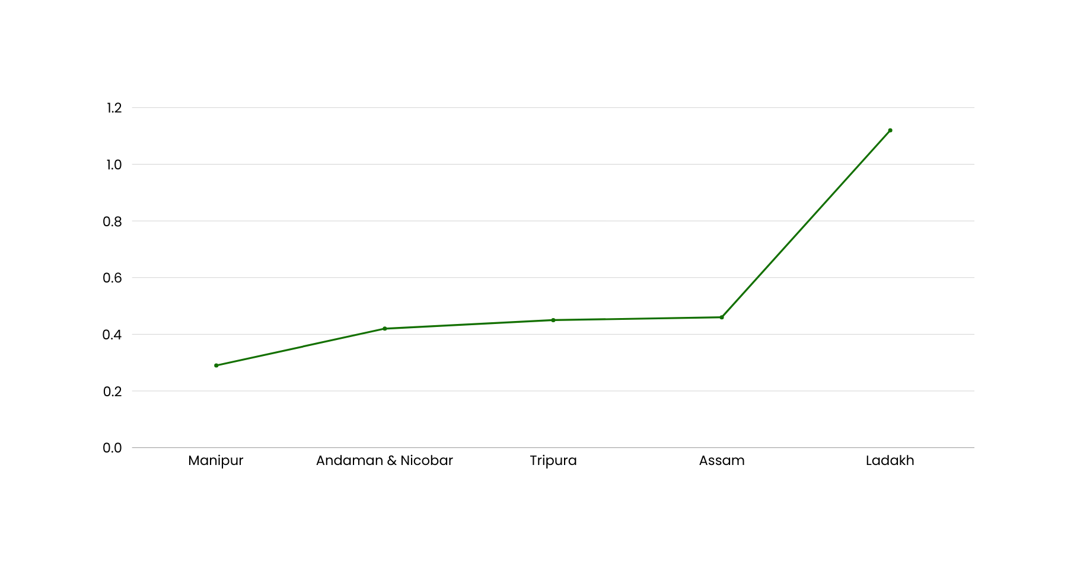
States with Negative EV Sales Growth

Slide 38
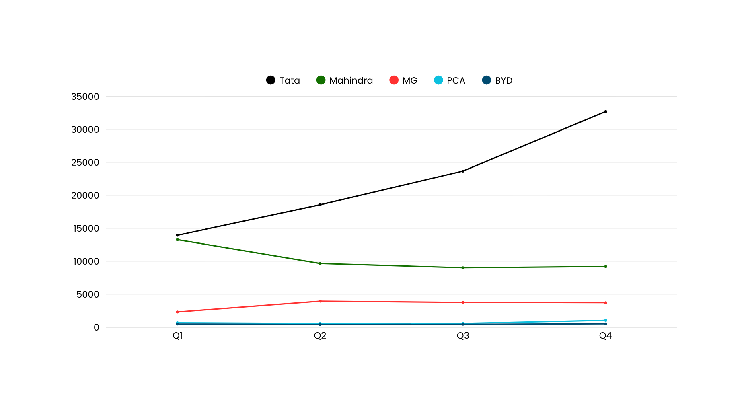
States with Negative EV Sales Growth

Slide 39
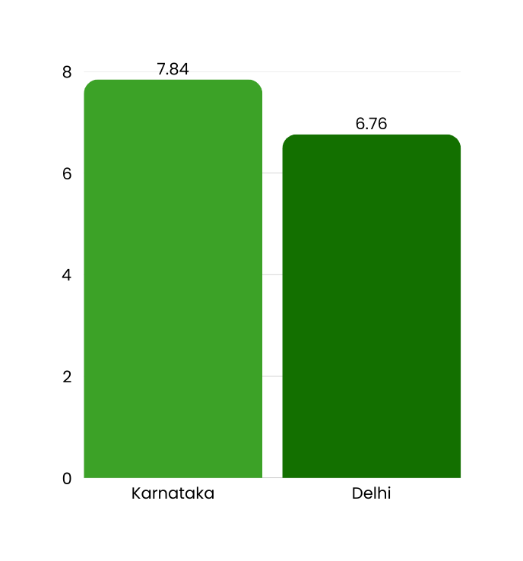

Regional EV Penetration: Delhi vs Karnataka
Comparing EV Adoption Rates in Regions
Insights into market penetration trends

Slide 40
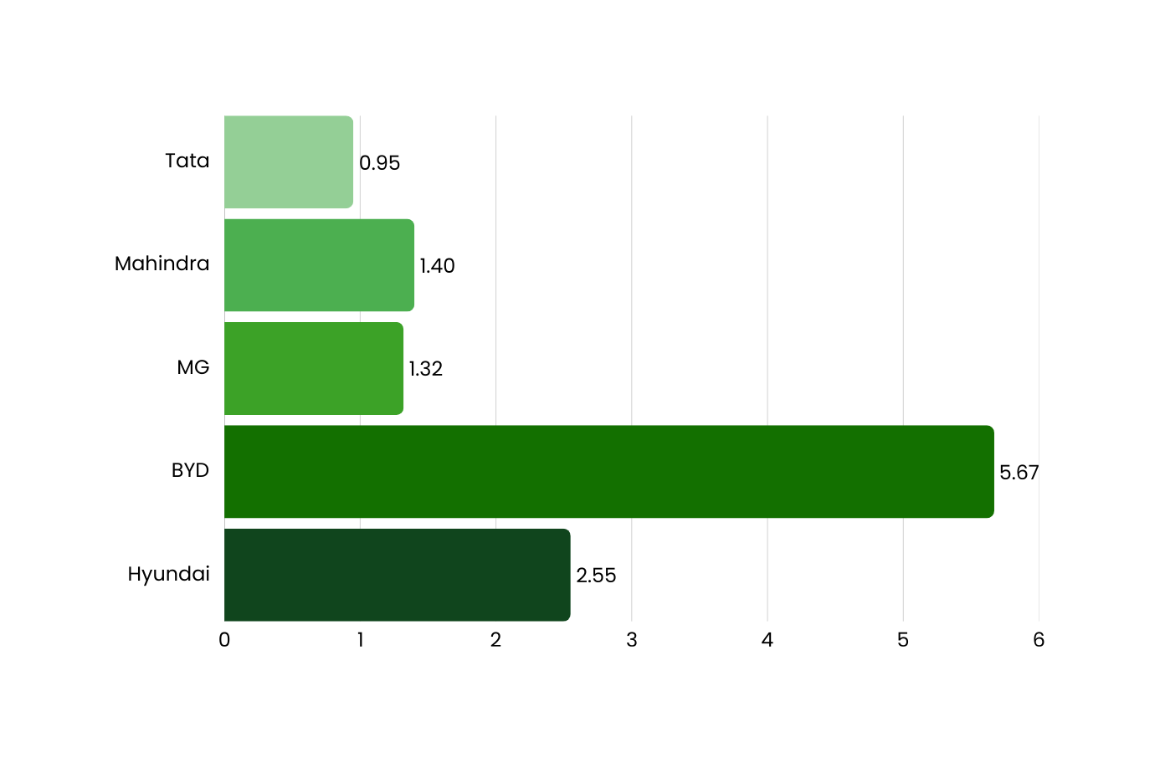
CAGR in 4W Sales for Top 5 Makers

Slide 41
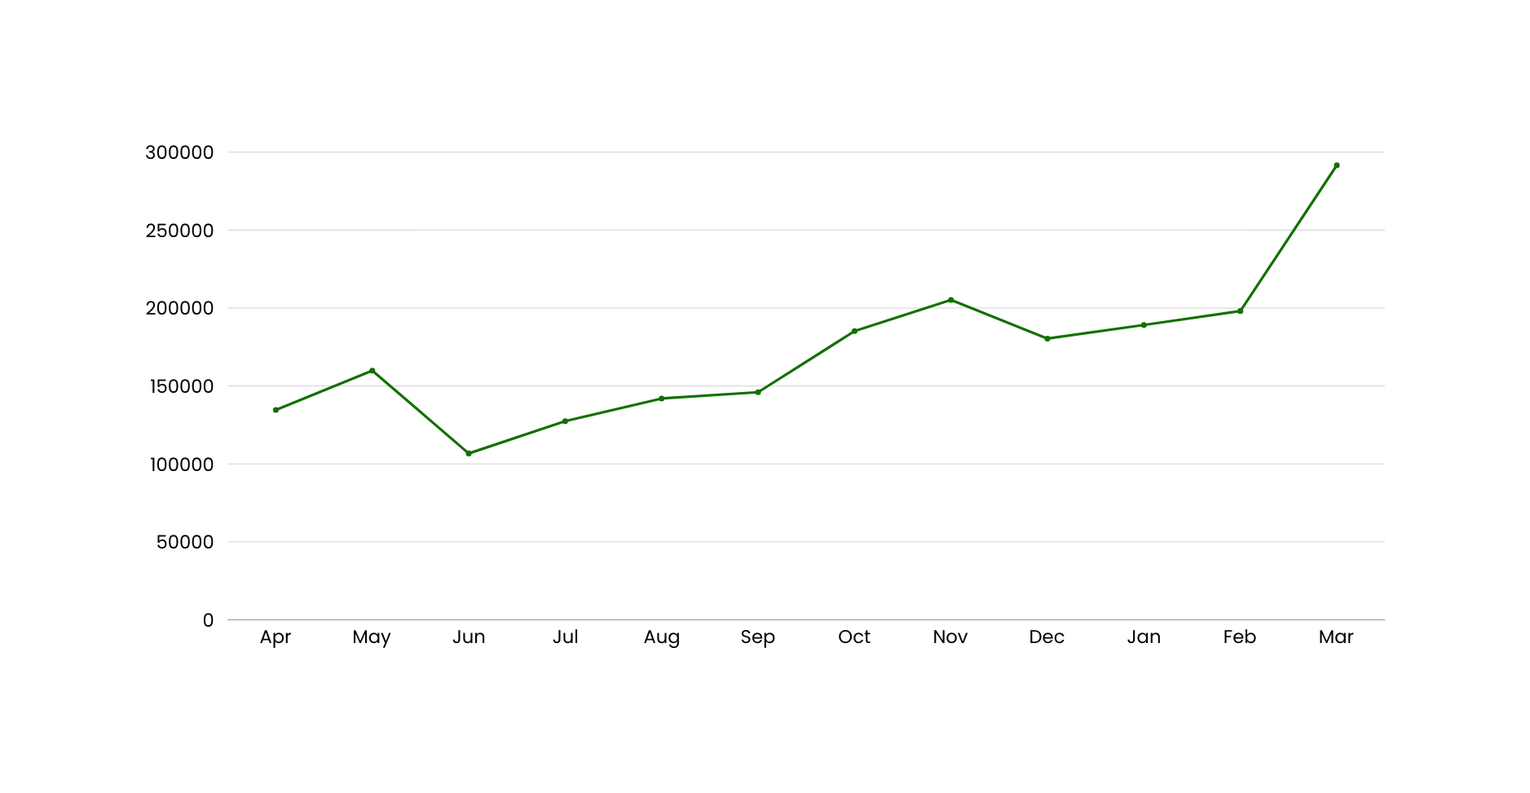
Peak & Low Season Months for EV Sales

Slide 42
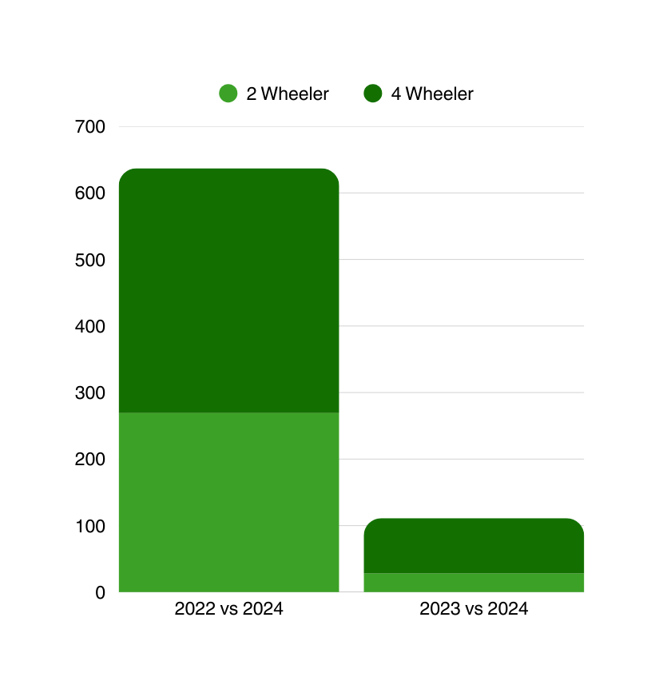
Revenue Growth Rate of 2W & 4W EV’s in India
The significant drop in the Revenue Growth % is due to Base Effect.

Slide 43
Top 10 States by CAGR in Vehicle Sales
State | CAGR%
Chhatisgarh | 150.89%
West Bengal | 150.62%
Goa | 146.45%
Uttar Pradesh | 137.70%
Madhya Pradesh | 133.67%
Kerala | 132.83%
Gujarat | 116.33%
Odisha | 102.94%
Maharashtra | 101.89%
Karnataka | 93.24%
Reduced Volume EV Avoided Sold States: A few of states exhibit CAGRs more than 100%, but their absolute volumes are still modest. states that only have Agg. Between 2022 and 2024, sales will exceed 15,000.

Slide 44
Projected EV Sales for
Top 10 States by 2030
State | Total Sales
Maharashtra | 949,561
Karnataka | 679,629
Tamil Nadu | 507,091
Uttar Pradesh | 432,876
Andhra Pradesh | 415,751
Gujarat | 323,169
Kerala | 251,612
Chattisgarh | 116,801
Delhi | 115,430
Jammu & Kashmir | 61,559
The project sales data is generated from historical data and tend to change anytime due to government policy, social trends, economic conditions and much more.

Slide 45
Strategic Market Entry
Actionable insights for successful growth
45

Slide 46

Identifying the Optimal State for EV Manufacturing Unit
Tamil Nadu will be the optimal state for setting up a Manufacturing unit for AtliQ Motors because
A Positive Business Environment
The state is a fantastic option for a long-term investment because of its high ranking for ease of doing business, political stability, and strong emphasis on sustainability.
Automobile Center
Tamil Nadu is a significant hub for the automotive sector, with well-established suppliers and facilities that facilitate the establishment and operation of a manufacturing facility.
When it comes to ease of doing business, Tamil Nadu often ranks among the top 3 Indian states.
More than 35% of India's total vehicle production comes from Tamil Nadu.
Outstanding Infrastructure
Expert Staff
Tamil Nadu offers simple access to raw resources and export markets because to its well-developed ports, roadways, and industrial parks.
Thanks to its numerous technical institutes and long history of producing automobiles, Tamil Nadu boasts a sizable pool of highly qualified workers and engineers.
Over 60% of India's automobile exports are handled by Chennai Port.
Every year, the state generates more than 2 lakh engineering graduates, guaranteeing a consistent supply of skilled workers.
Authority Support
The state promotes investment in the production of electric vehicles by providing alluring incentives, subsidies, and a robust EV policy.
By 2025, the Tamil Nadu government wants to bring in ₹50,000 crores in investments for the EV industry.
46
Backup Options: Gujarat, Maharashtra, Uttar Pradesh

Slide 47

Ideal Brand Ambassador
for AtliQ Motors’ EV Launch in India
WHY?
Youth appeal
Known for energy & tech-forward image
Already associated with sustainability campaigns
High influence in Tier 1 cities (major EV markets)

Slide 48


Optional Alternates
R Madhavan
Virat Kohli
Premium + Tech Audience
Pan - India Trust

Slide 49
Recommendations for AtliQ Motors
Invest in Charging Infrastructure
Prior to joining the Indian EV market, make investments and open additional public charging stations throughout the country to allay worries about range.
Make Use of Government Assistance
Utilize all of the subsidies, tax breaks, lower GST, and other programs designed to help firms enter new markets.
Made in India
Establish a manufacturing facility in Tamil Nadu since the state offers more advantageous regulations and incentives to lower production costs and expedite market access.
Develop a Robust Brand Awareness
The most crucial piece of advice is that Atliq Motors can leave a lasting impression on consumers by developing a strong brand presence through creative advertising and marketing initiatives.
49

Slide 50
DASHBOARD SCREENSHOT
50

Slide 51
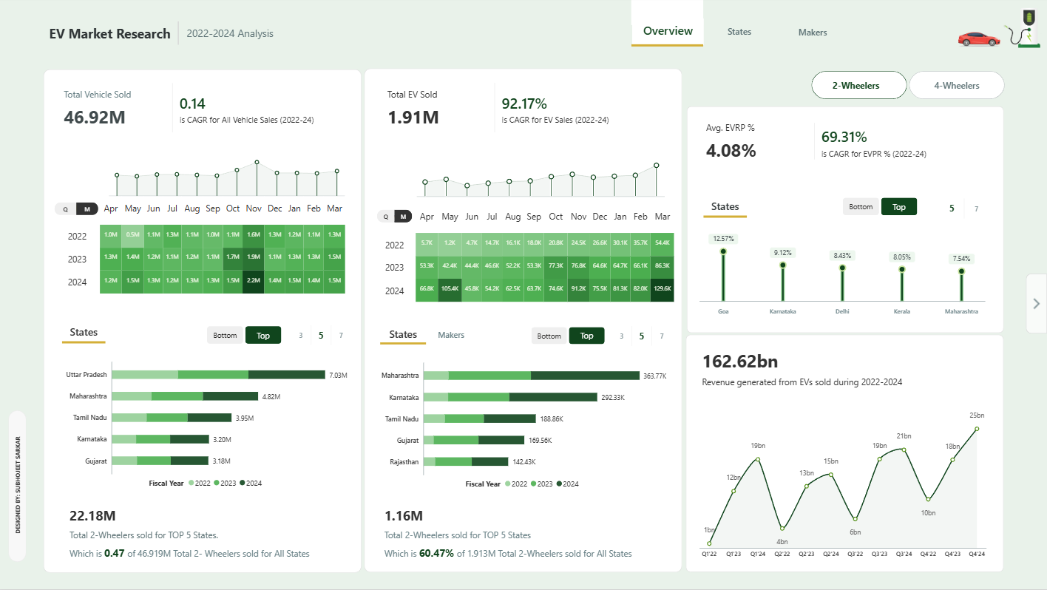
51

Slide 52
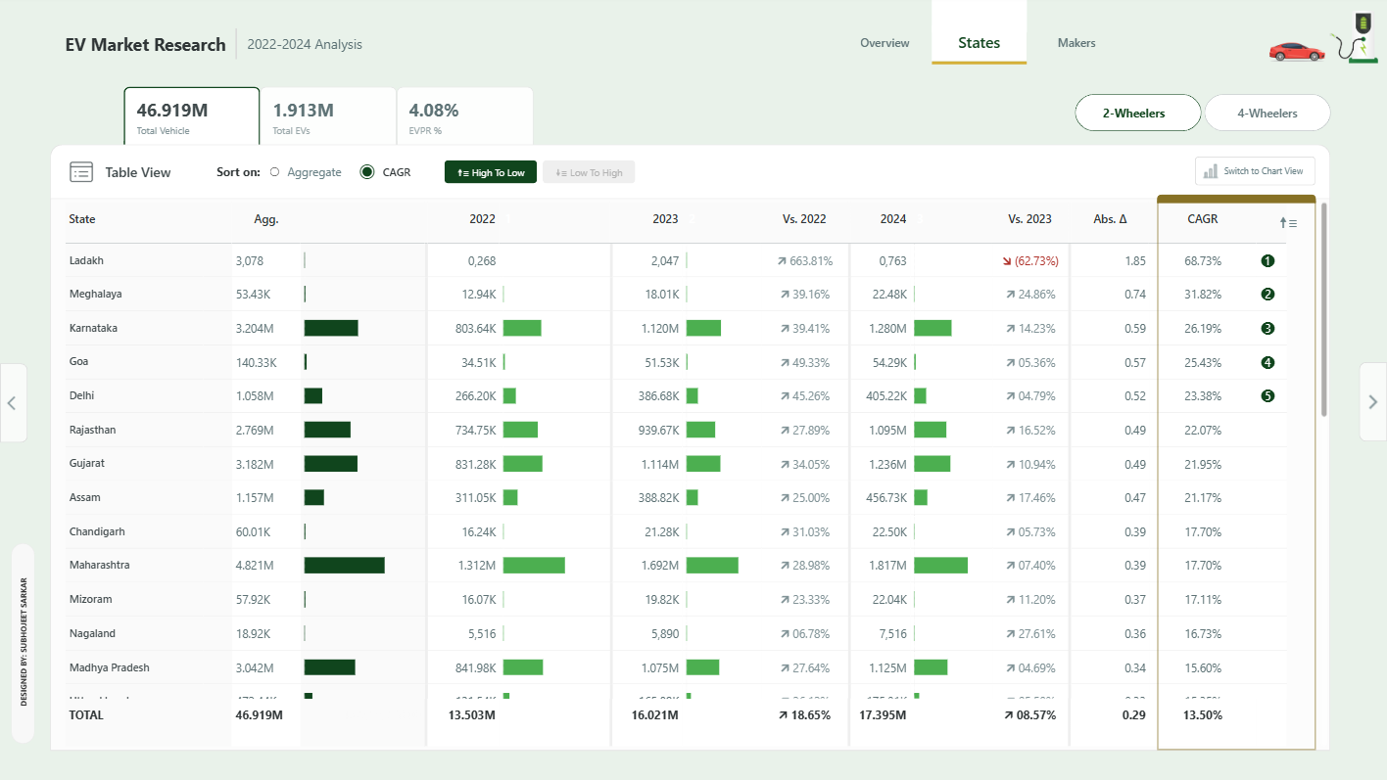
52

Slide 53
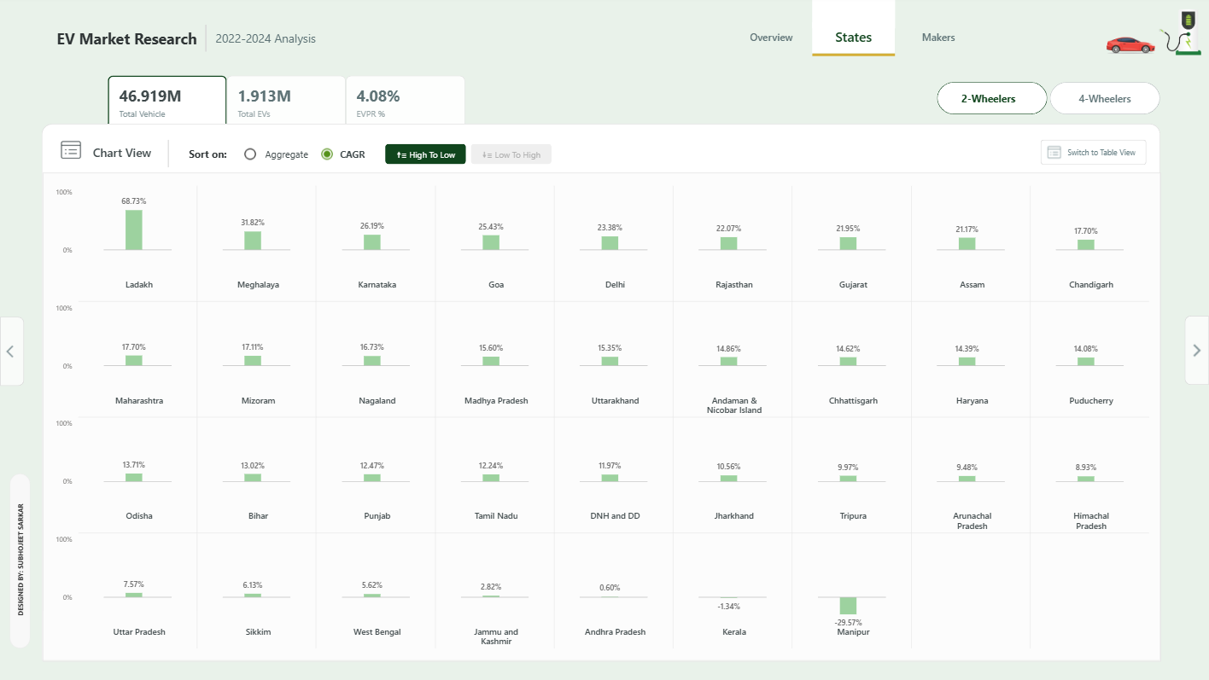
53

Slide 54
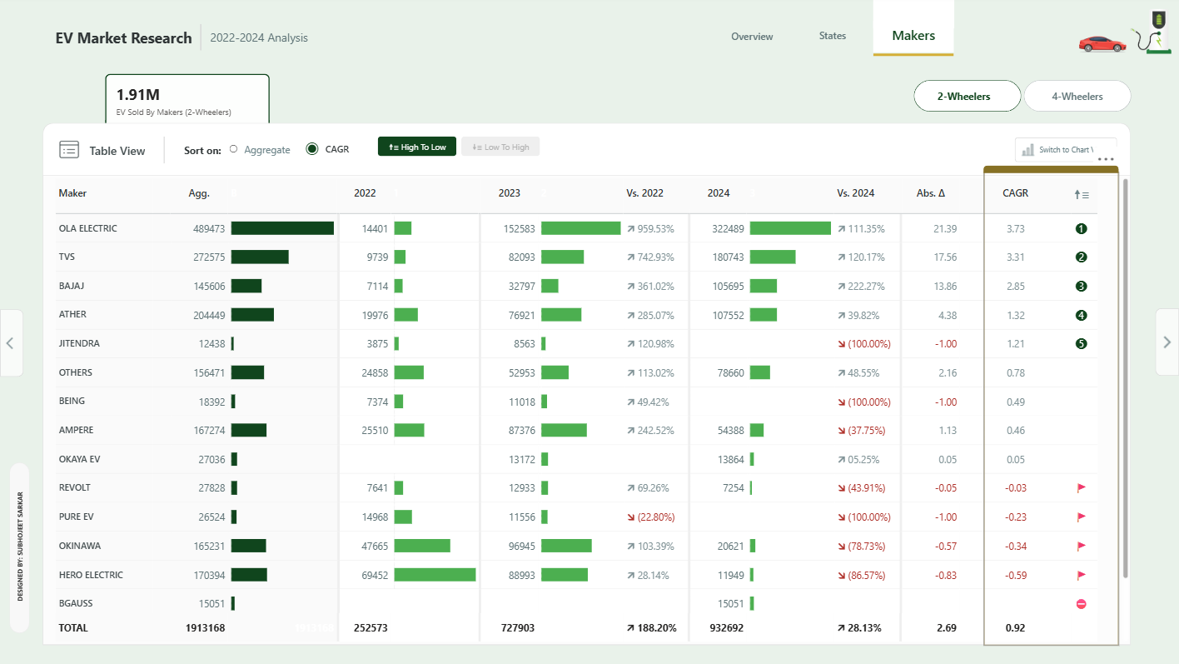
54

Slide 55
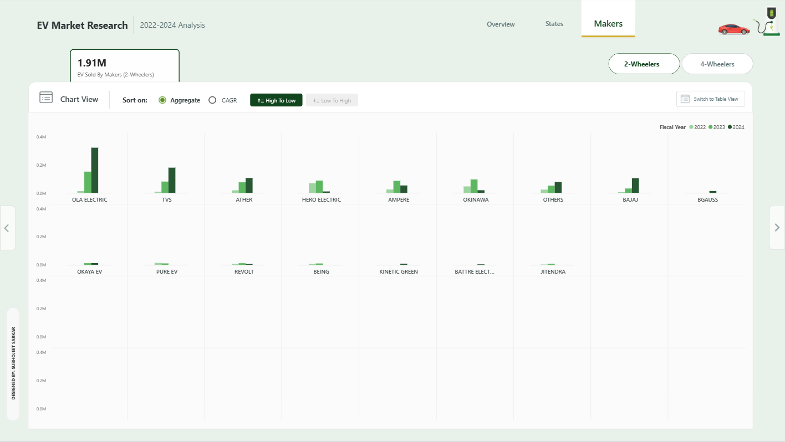
55

Slide 56
THANKYOU
56

